Slide 1


Millicent A. P.
10/6/2023

Slide 2


Table of Contents
1..Executive Summary
2.Introduction
3.Methodology
.Data Collection
.Data Wrangling
4.Results
.Data Analysis
.Data Visualization
5.Conclussions
6.Appendix

Slide 3

Introduction
PROJECT BACKGROUND AND CONTEXT
The project was carried out to predict if the Falcon 9 rocket launches on its website with a cost of $62 million ,other providers cost upward of $165 million each.Much of the savings is attributed to the fact that Spacex reuses the First stage.
Therefore if we can determine if the first stage will land ,we can determine the cost of a Launch.
This information can be used if an alternate company wants to bid against Spacex for a Rocket Launch.
Common Problems to be solved
1.What influences if the rocket will land successfully?
2.The effect of each relationship with certain rocket variables will impact in determining the success rate of a successful landing.
3.What conditions does Spacex have to achieve to get the best results and ensure the best rocket success landing rate.

Slide 4

Executive Summary
Summary of methodologies
Summary of all results
https://github.com/MillyAP/SPACEX-PROJECT

Slide 5

Section 1

Slide 6
Methodology
Data Collection Methodology
1.Spacex Rest API
2.Webscraping from Wikipedia
Performed Data Wrangling
Cleaning of Data &Encoding them to be in the right format for easy analysis
Performed Exploratory Data Analysis(EDA) visualization and SQL (Plotting scatter graphs and bar graphs to show relationship between variables & to show patterns in data)
Performed Interactive Visual Analytics using Folium & Plotly Dash
Performed Predictive Analysis using (classification )models
Building ,tuning and evaluating classification models
https://github.com/MillyAP/SPACEX-PROJECT

Slide 7



Data Collection
Source
Rest API
Webscraping
Data sets were collected by;
Spacex Rest API –api.spacexdata.com/v4/
Webscraping Wikipedia using Beautifulsoup
Collecting data with API call
Creating the beautifulsoup
Getting column names
Converting to dataframe with the help of JSON
Creating the launch_dict
Updating columns and rows(preprocessing)
Filtering the data to keep only Falcon 9 launches
Converting to final dataframe
Convert the data to CSV file
Convert data to CSV file

Slide 8
Data Collection – SpaceX API
Source
REST API
Rest API
Data sets were collected by;
Spacex Rest API –api.spacexdata.com/v4/
https://github.com/MillyAP/SPACEX-PROJECT
Collecting data with API call
Converting to dataframe with the help of JSON
Updating columns and rows(preprocessing)
Filtering the data to keep only Falcon 9 launches
Convert the data to CSV file

Slide 9
Data Collection - Scraping
Source
Webscraping
Data sets were collected by;
Webscraping Wikipedia using Beautifulsoup
https://github.com/MillyAP/SPACEX-PROJECT
Creating the beautifulsoup
Getting column names
Creating the launch_dict
Converting to final dataframe
Convert data to CSV file

Slide 10
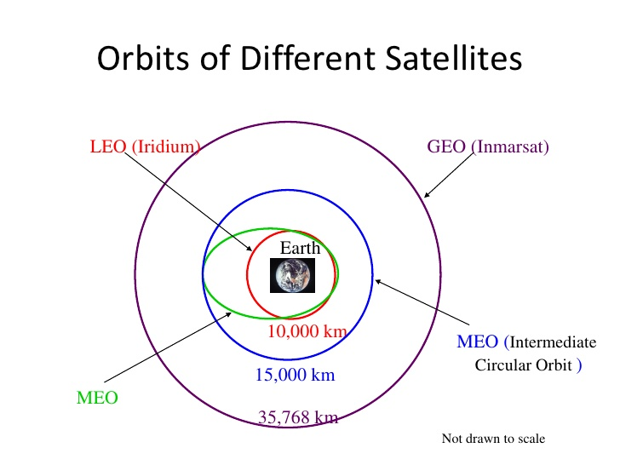
Data Wrangling
Exploratory Data Analysis-EDA Process
Calculate the number of Launches on each site
Calculate the number and occurrence of mission outcome per orbit type
Export dataset as CSV
Calculate the number of occurrence for each Orbit
Work out Success Rate for every landing in dataset
Create landing outcomes Labels from outcome column
Each launch aims to an dedicated orbit ,and here are some common orbit types
Notes:
https://github.com/MillyAP/SPACEX-PROJECT

Slide 11
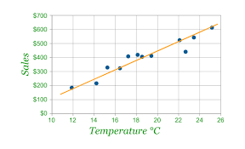
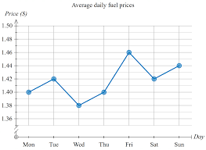
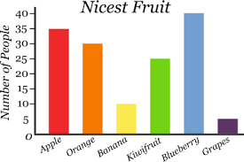
EDA with Data Visualization
Scatter Graphs
Bar Graphs
Line Graphs
Show how much one variable is affected by another.The relationship between the two variables is called their correlation .Its usually used in a large body of data.
Flight No. Vs Payload mass,
Flight No. Vs Launch site,
Orbit Vs Flight No.,
Payload Vs Orbit type,
Orbit Vs Payload Mass
It makes it easy to compare sets of data between different groups at a glance.The graph represents categories on one axis and a discrete value in the other.The goal is to show the relationship between the two axes .Bar charts can also show big changes in data overtime.
Mean Vs Orbit
They are useful in that they show data variables and trends very clearly and can help to make predictions about the results of data not yet recorded.
Success Rate Vs Year

Slide 12
EDA with SQL
Display the names of the unique launch sites in the space mission
Display 5 records where launch sites begin with the string 'CCA'
Display the total payload mass carried by boosters launched by NASA (CRS)
Display average payload mass carried by booster version F9 v1.1
List the date when the first successful landing outcome in ground pad was achieved.
List the names of the boosters which have success in drone ship and have payload mass greater than 4000 but less than 6000
List the total number of successful and failure mission outcomes
List the names of the booster versions which have carried the maximum payload mass. Use a subquery
List the records which will display the month names, failure landing_outcomes in drone ship ,booster versions, launch site for the months in year 2015.
Rank the count of successful landing_outcomes between the date 04-06-2010 and 20-03-2017 in descending order.

Slide 13
Build an Interactive Map with Folium
Folium.Marker() was used to create marks on the maps
Folium Circle () was used to create circles above markers on the map
Folium.Icon() was used to create an icon on the map
Folium.polyline() was used to create polynomial line between the points
Folium.plugins.Antipath()was used to create animated line between the points
Marker clusters() was used to simplify the maps which contain several markers with identical coordination
https://github.com/MillyAP/SPACEX-PROJECT

Slide 14
Building a Dashboard with plotly Dash
Dash and Html components were used as they are the most important thing on visualization.
Plotly was used to create graphs ,pie charts ,scatterplots
Rangeslider was used for Payload mass range selection
https://github.com/MillyAP/SPACEX-PROJECT

Slide 15
Predictive Analysis (Classification)
1.Building the model
Create column for the class
Standardize the data
Split the data into Train and Test sets
Build the GridsearchCV model and fit the data
2. Evaluating the model
Calculate the accuracies
Calculate the Confusion matrices
Plot the results
3.Finding the optimal model
Finding the best hyper parameters for the model
Find the best model with highest accuracy
Confirm the optimal model
https://github.com/MillyAP/SPACEX-PROJECT

Slide 16
Results
Exploratory data analysis results
Interactive analytics demo in screenshots
Predictive analysis results
https://github.com/MillyAP/SPACEX-PROJECT

Slide 17

Section 2

Slide 18
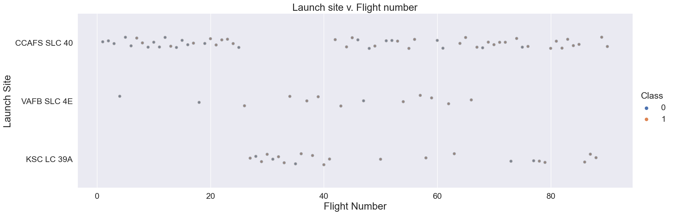
Flight Number vs. Launch Site

Slide 19
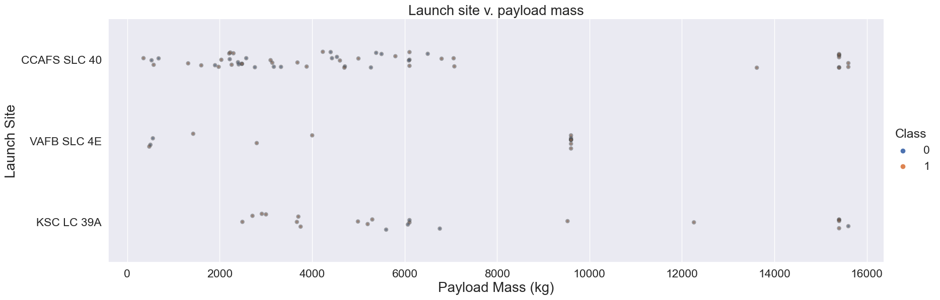
Payload vs. Launch Site

Slide 20
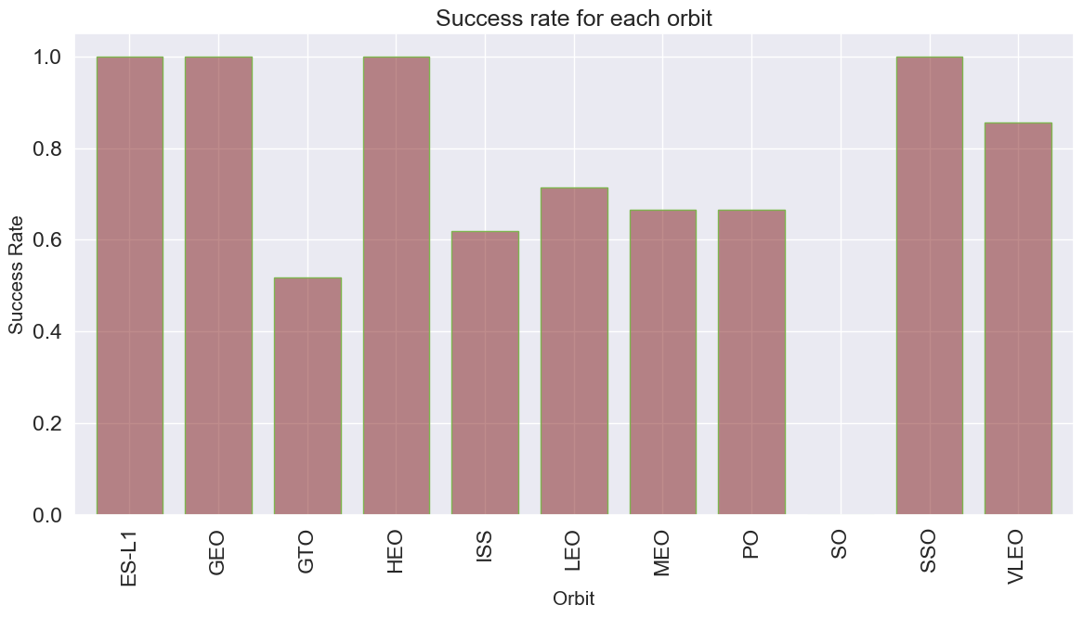
Success Rate vs. Orbit Type

Slide 21
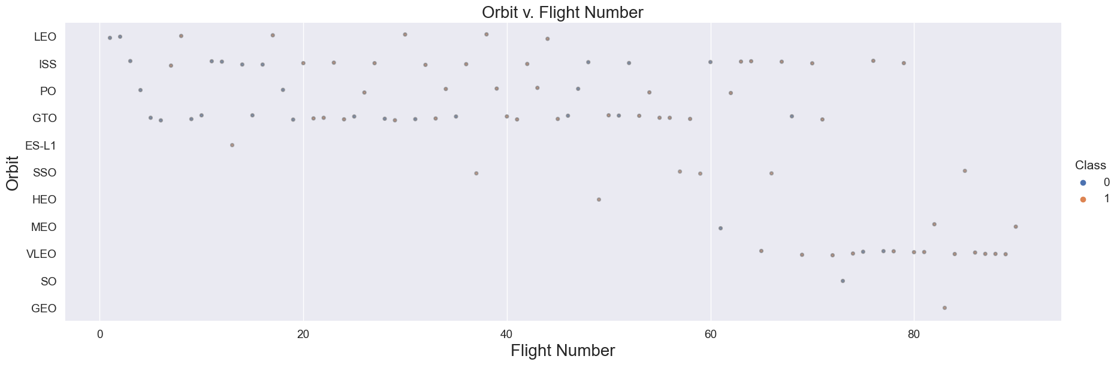
Flight vs. Orbit Type

Slide 22
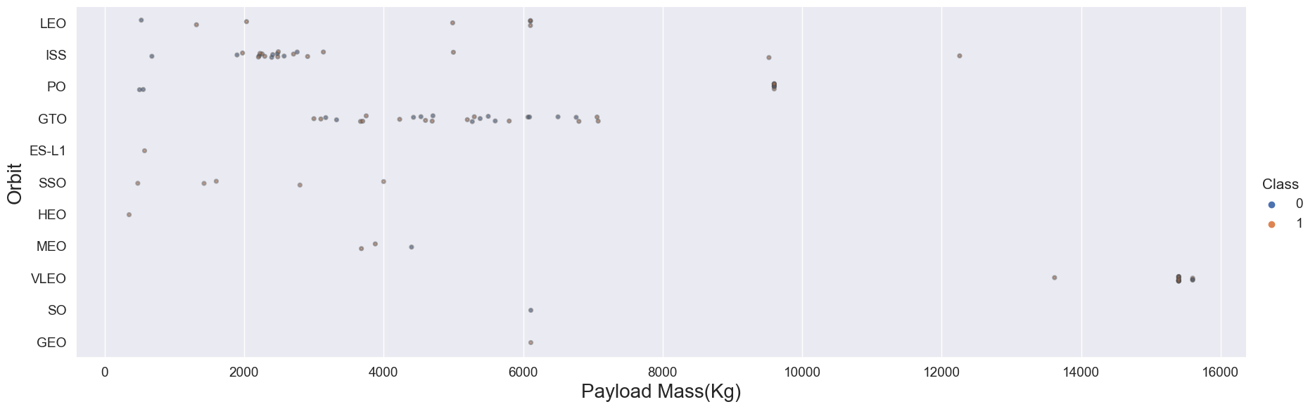

Payload vs. Orbit Type

Slide 23
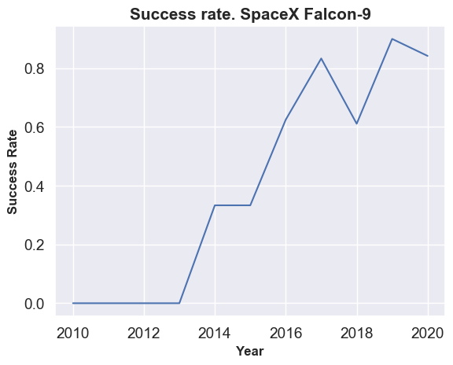
Launch Success Yearly Trend

Slide 24
All Launch Site Names
task_1 = '''
SELECT DISTINCT LaunchSite
FROM SpaceX
launchsite
0 | KSC LC-39A
1 | CCAFS LC-40
2 | CCAFS SLC-40
3 | VAFB SLC-4E

Slide 25
Launch sites begin with ‘CCA’
df_launchsites_CCA5=pd.read_sql_query("Select distinct Launch_Site from spacex_v11 where Launch_Site Like 'CCA%' Limit 5",conn)
d | Date | Time (UTC) | Booster_Version | Launch_Site | Payload | PAYLOAD_MASS__KG_ | Orbit | Customer | Mission_Outcome | Landing_Outcome
0 | 1 | 2010-04-06 | 0 days 18:45:00 | F9 v1.0 B0003 | CCAFS LC-40 | Dragon Spacecraft Qualification Unit | 0 | LEO | SpaceX | Success | Failure (parachute)
1 | 2 | 2010-08-12 | 0 days 15:43:00 | F9 v1.0 B0004 | CCAFS LC-40 | Dragon demo flight C1, two CubeSats, barrel of... | 0 | LEO (ISS) | NASA (COTS) NRO | Success | Failure (parachute)
2 | 3 | 2012-05-22 | 0 days 07:44:00 | F9 v1.0 B0005 | CCAFS LC-40 | Dragon demo flight C2 | 525 | LEO (ISS) | NASA (COTS) | Success | No attempt
3 | 4 | 2012-10-08 | 0 days 00:35:00 | F9 v1.0 B0006 | CCAFS LC-40 | SpaceX CRS-1 | 500 | LEO (ISS) | NASA (CRS) | Success | No attempt
4 | 5 | 2013-03-01 | 0 days 15:10:00 | F9 v1.0 B0007 | CCAFS LC-40 | SpaceX CRS-2 | 677 | LEO (ISS) | NASA (CRS) | Success | No attempt

Slide 26
Total Payload Mass
task_3 = '''
SELECT SUM(PayloadMassKG) AS Total_PayloadMass
FROM SpaceX
WHERE Customer LIKE 'NASA (CRS)'
'''
total_payloadmass
45596

Slide 27
Average Payload Mass by F9 v1.1
task_4 = '''
SELECT AVG(PayloadMassKG) AS Avg_PayloadMass
FROM SpaceX
WHERE BoosterVersion = 'F9 v1.1'
'''
avg_payloadmass
2928.4

Slide 28
First Successful Ground Landing Date
task_5 = '''
SELECT MIN(Date) AS FirstSuccessfull_landing_date
FROM SpaceX
WHERE LandingOutcome LIKE 'Success (ground pad)'
'''
firstsuccessfull_landing_date
2015-12-22

Slide 29
Successful Drone Ship Landing with Payload between 4000 and 6000
task_6 = '''
SELECT BoosterVersion
FROM SpaceX
WHERE LandingOutcome = 'Success (drone ship)'
AND PayloadMassKG > 4000
AND PayloadMassKG < 6000
'''
boosterversion
0 F9 FT B1022
1 F9 FT B1026
2 F9 FT B1021.2
3 F9 FT B1031.2

Slide 30
Total Number of Successful and Failure Outcomes
Successful Outcomes
Failure Outcomes
task_7a = '''
SELECT COUNT(MissionOutcome) AS SuccessOutcome FROM SpaceX
WHERE MissionOutcome LIKE 'Success%'
'‘’
The total number of successful mission outcome is:
Success outcome
0 100
task_7b = '''
SELECT COUNT(MissionOutcome) AS FailureOutcome FROM SpaceX
WHERE MissionOutcome LIKE 'Failure%’
The total number of failed mission outcome is:
Failure outcome
0 1

Slide 31
Boosters Carried Maximum Payload
task_8 = '''
SELECT BoosterVersion, PayloadMassKG FROM SpaceX WHERE PayloadMassKG = ( SELECT MAX(PayloadMassKG) FROM SpaceX ) ORDER BY BoosterVersion
boosterversion payloadmasskg
0 F9 B5 B1048.4 15600
1 F9 B5 B1048.5 15600
2 F9 B5 B1049.4 15600
3 F9 B5 B1049.5 15600
4 F9 B5 B1049.7 15600
5 F9 B5 B1051.3 15600
6 F9 B5 B1051.4 15600
7 F9 B5 B1051.6 15600
8 F9 B5 B1056.4 15600
9 F9 B5 B1058.3 15600
10 F9 B5 B1060.2 15600
11 F9 B5 B1060.3 15600

Slide 32
2015 Launch Records
task_9 = '''
SELECT BoosterVersion, LaunchSite, LandingOutcome
FROM SpaceX
WHERE LandingOutcome LIKE 'Failure (drone ship)'
AND Date BETWEEN '2015-01-01' AND '2015-12-31'
'''
boosterversion launchsite landingoutcome
0 F9 v1.1 B1012 CCAFS LC-40 Failure (drone ship)
1 F9 v1.1 B1015 CCAFS LC-40 Failure (drone ship)

Slide 33
Rank Landing Outcomes Between 2010-06-04 and 2017-03-20
task_10 = '''
SELECT LandingOutcome, COUNT(LandingOutcome) FROM SpaceX
WHERE DATE BETWEEN '2010-06-04' AND '2017-03-20’ GROUP BY LandingOutcome ORDER BY COUNT(LandingOutcome) DESC
landingoutcome count
0 No attempt 10
1 Success (drone ship) 6
2 Failure (drone ship) 5
3 Success (ground pad) 5
4 Controlled (ocean) 3
5 Uncontrolled (ocean) 2
6 Precluded (drone ship) 1
7 Failure (parachute) 1

Slide 34

Section 3

Slide 35
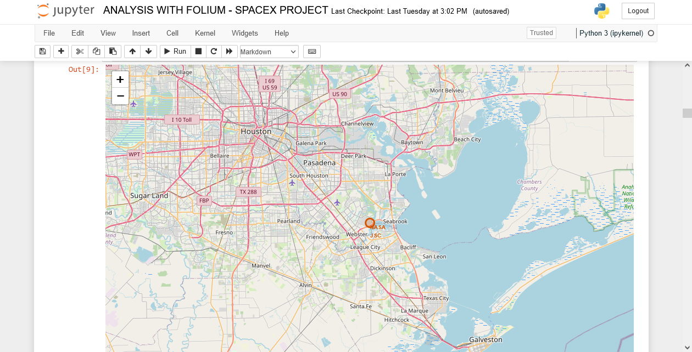
use folium.Circle to add a highlighted circle area with a text label on a specific coordinate

Slide 36
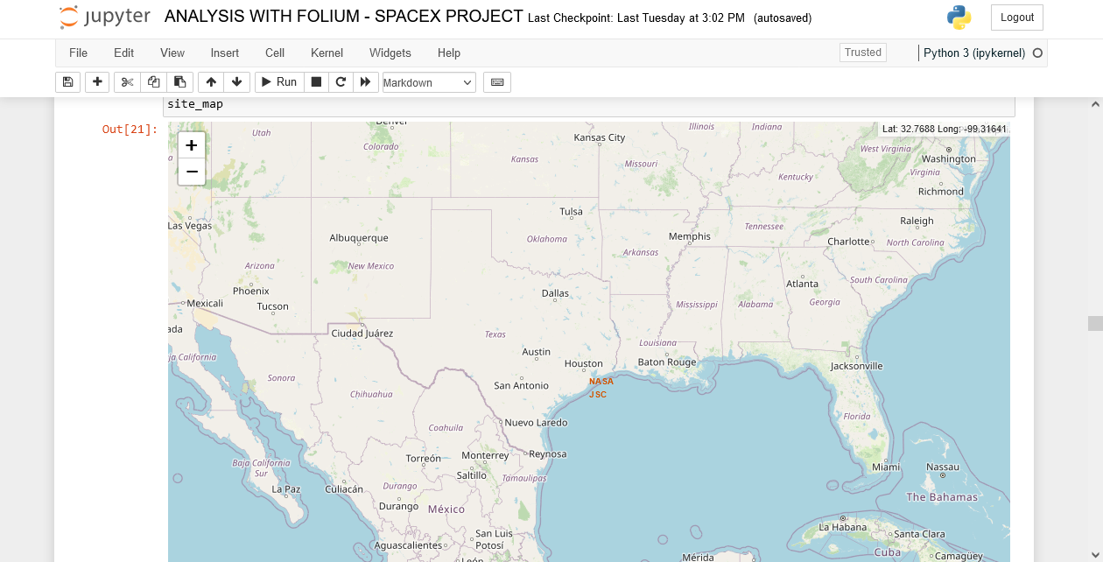
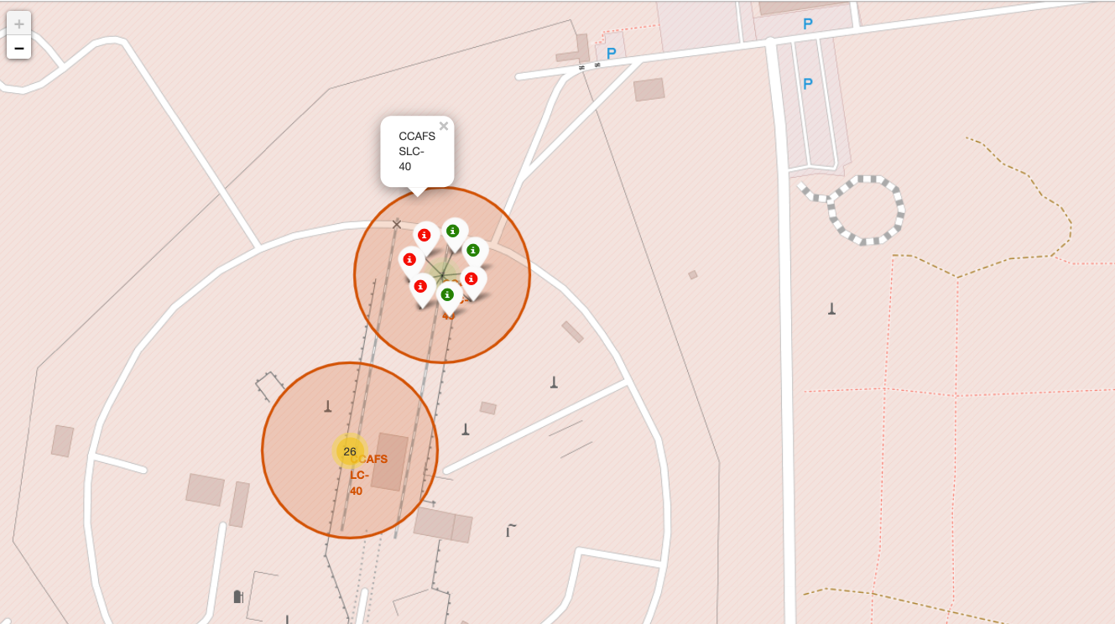
Color Labeled launch outcomes

Slide 37
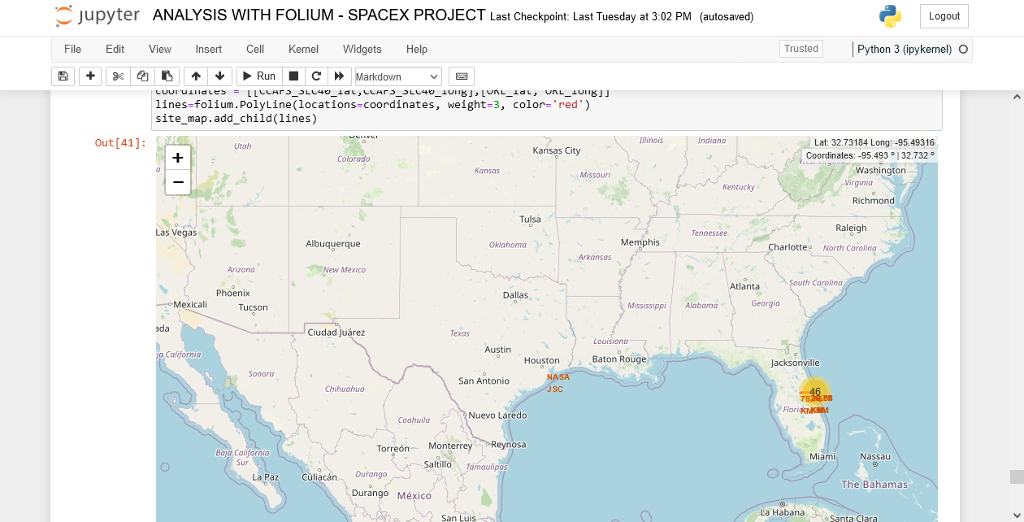
Proximity to a coast line

Slide 38

Section 4

Slide 39
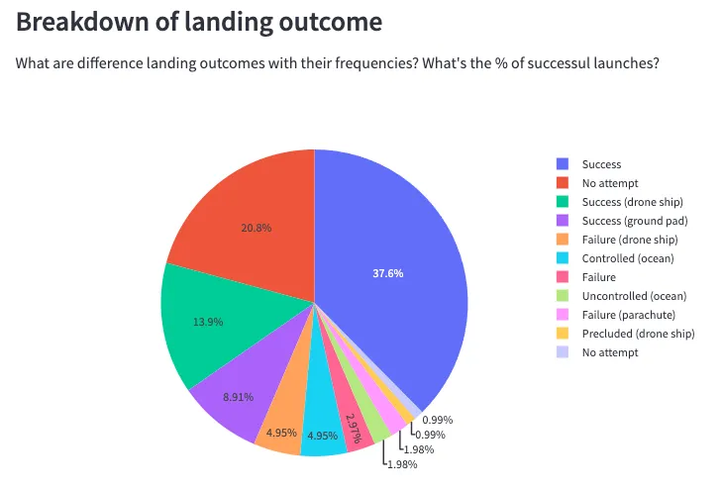
Launch success

Slide 40
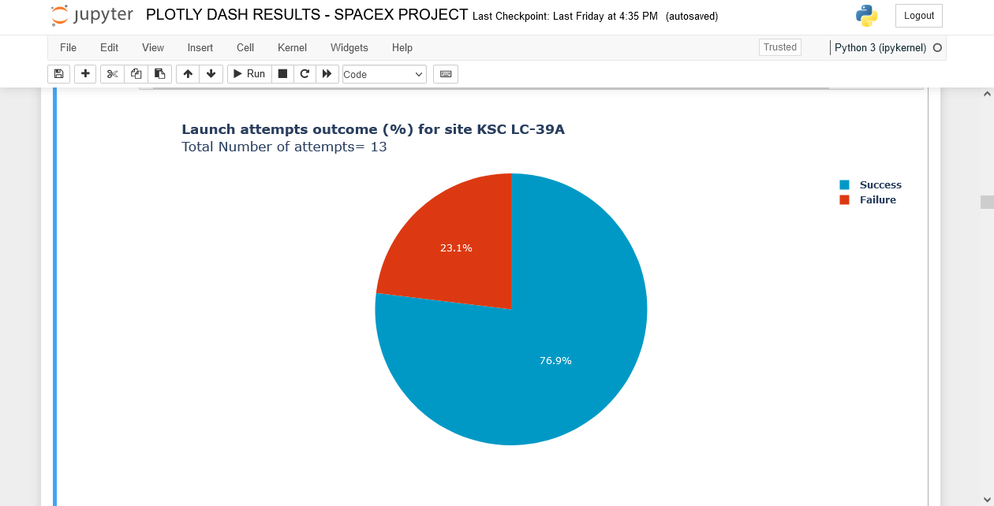
Launch site with the highest success ratio

Slide 41
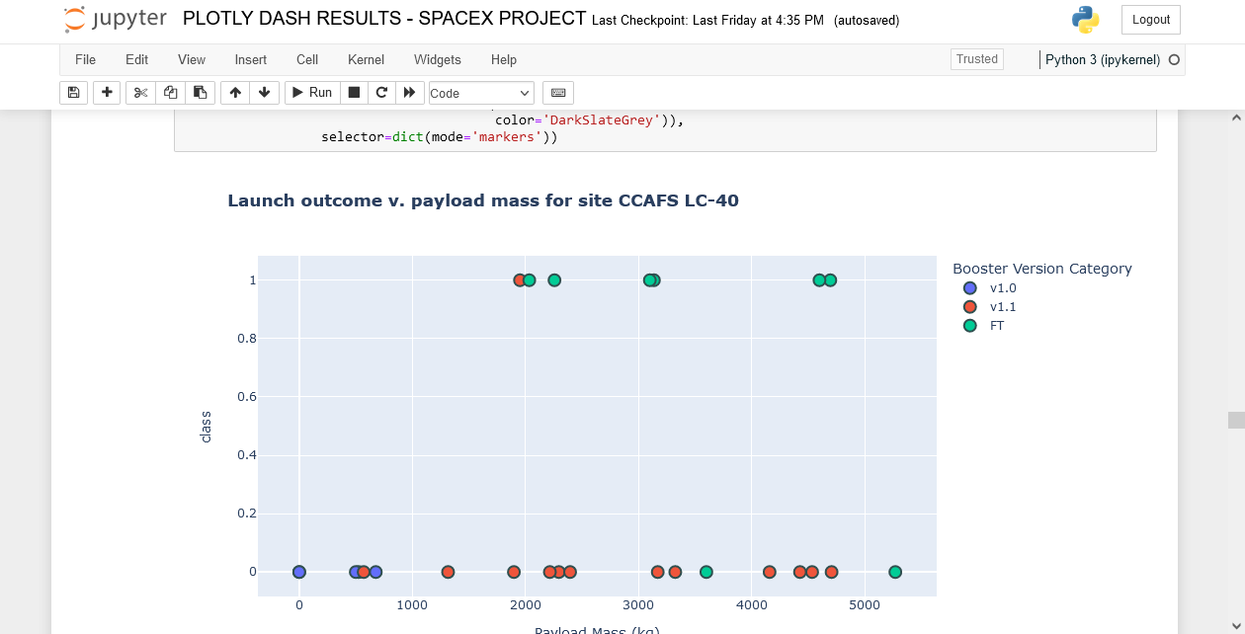
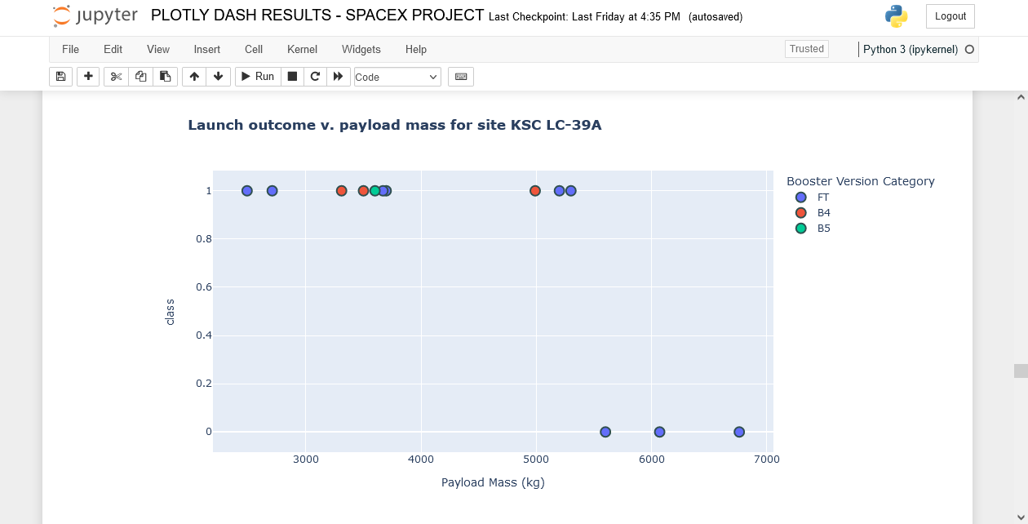
Payload Vs. Launch Outcome scatter plot

Slide 42
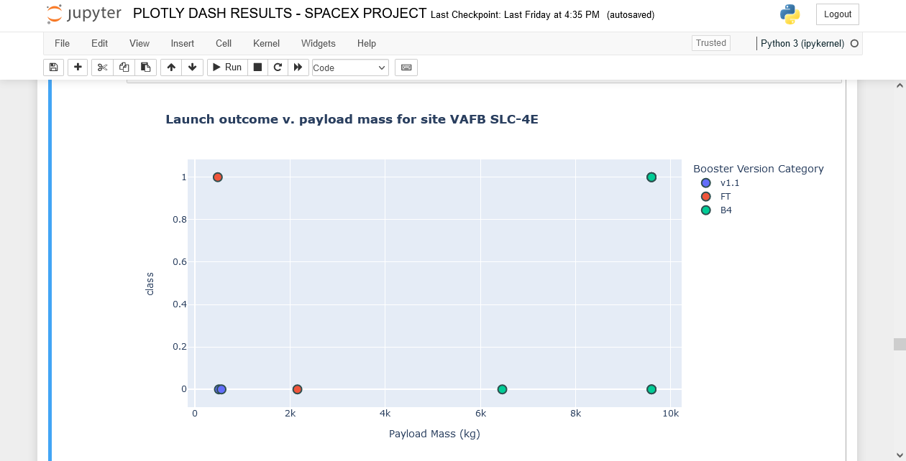
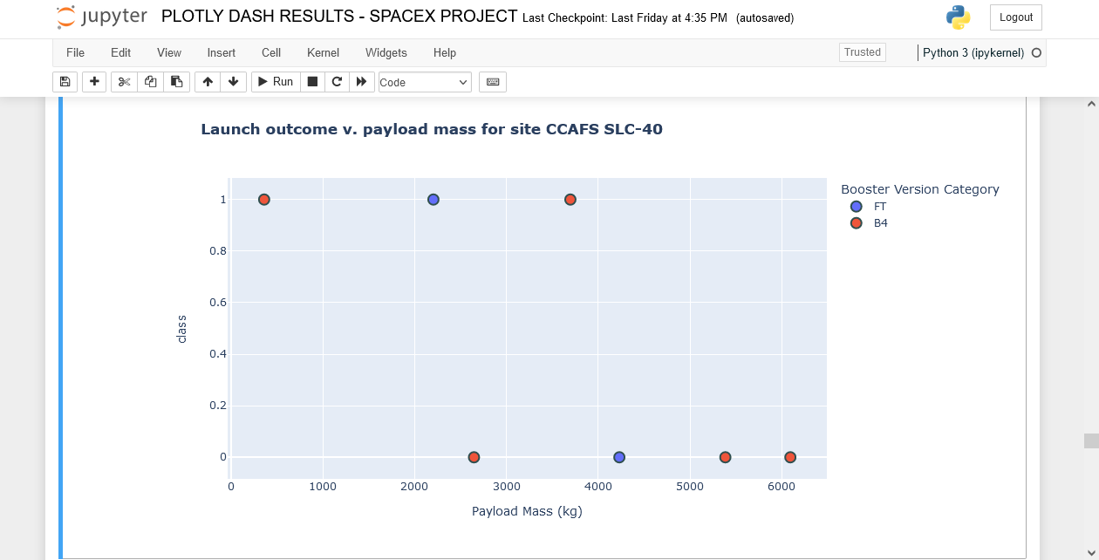

Slide 43
Report
After visual analysis using the dashboard, you should be able to obtain some insights to answer the following five questions:
Which site has the largest successful launches?
KSLC-39A: 10 successful launches
Which site has the highest launch success rate?
KSLC-39A: ~77% or 10 successful launches out of 13
Which payload range(s) has the highest launch success rate?
Most successful launches have a payload mass in an interval [360-5300] kg
Which payload range(s) has the lowest launch success rate?
Above payload mass= 5400 Kg, there is only a single succesful launch, with a 9600 kg payload
Which F9 Booster version (v1.0, v1.1, FT, B4, B5, etc.) has the highest launch success rate?
Best booster version: FT: 15 successful launches out of 23 launch attempts. ~ 65% Second best: B4 = 6/11 about ~55%

Slide 44

Section 5

Slide 45
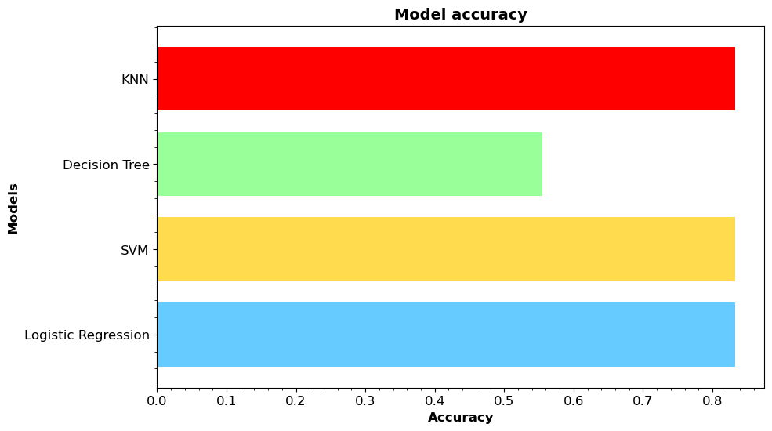
Classification Accuracy
Notes:
In our case,DECISION TREE is the LOW accurate method the others are at per

Slide 46
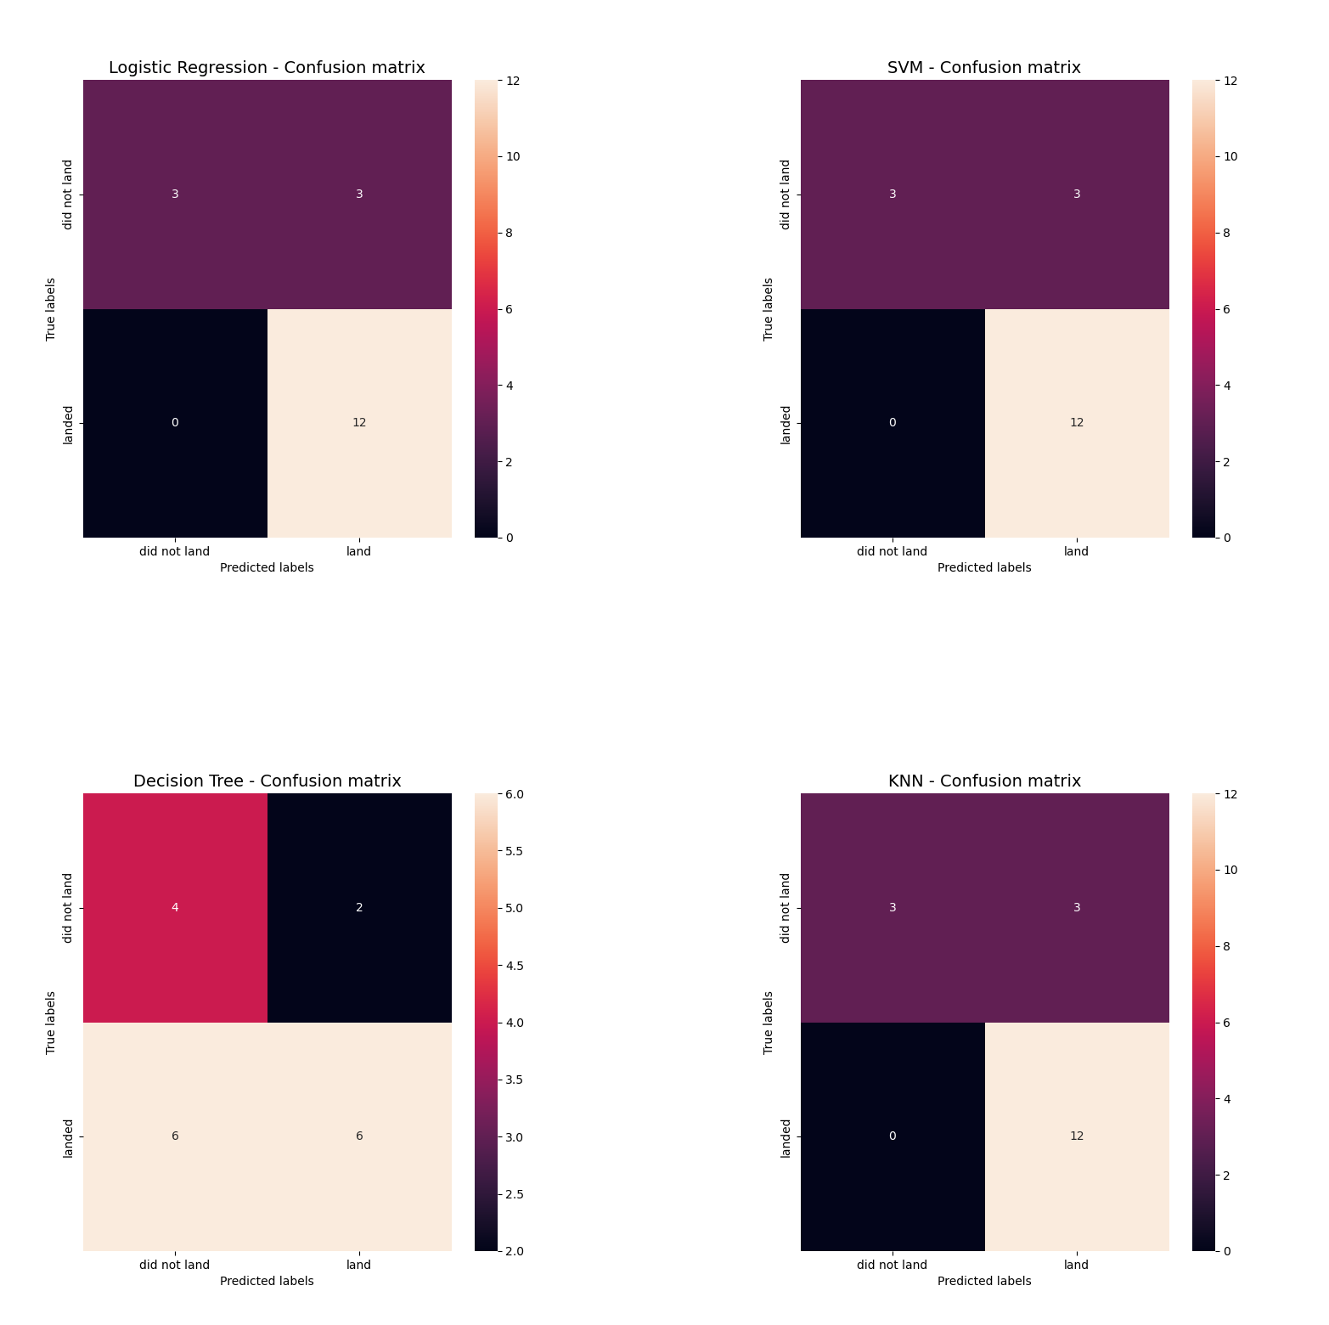
Confusion Matrix

Slide 47
Conclusions
After comparing accuracy of above methods, they all preformed practically
the same, except for Decision tree which fit train data slightly better but test data worse.
1.The Tree Classiffier algorithm is the best for machine learning for this dataset
2.Low weighted Payloads perform better than heavier Payloads
3.The Success Rates for Spacex launches is directly proportional to time in years ,they will eventually perfect the launches
4.KSC LC-39A had the most successful launches from all the sites
5.Orbit GEO,HEO,SSO,ES-L1 have the best success rate

Slide 48
Appendix
Include any relevant assets like Python code snippets, SQL queries, charts, Notebook outputs, or data sets that you may have created during this project
https://github.com/MillyAP/SPACEX-PROJECT

Slide 49


